Slide 1
Artificial Intelligence CS-202
Topic: Knowledge Representation
Habiba Arshad
Department of Computer Science
University of Wah

Slide 2
Week-10 CLO’s
This week lecture will cover the following CLO’s:
CLO1: Discuss the key concepts in the field of artificial intelligence
CLO 2: Implement artificial intelligence techniques and case studies

Slide 3
CLO’s Mapping
CLO 1:
Introduction to Knowledge Representation
CLO 2:
Case Studies: Knowledge-based Systems (Eliza, Student)

Slide 4
Knowledge Representation
Difference Among Data, Information, and Knowledge.
Importance of Differentiating These Terms.
Types of Knowledge Representation:
Logic-Based
Probabilistic-Based

Slide 5
Key Aspects of Representation
What is Knowledge Representation?
A critical part of Artificial Intelligence that focuses on organizing and structuring knowledge for machines to process and reason effectively.
Involves methods to encode information for reasoning and decision-making.
Enables AI systems to simulate human-like understanding and problem-solving.

Slide 6
Difference Among Data, Information, and Knowledge
Data
Raw, unprocessed facts or figures.
Example: Numbers, text, or measurements (e.g., "42," "Temperature = 30°C").
Information
Processed or structured data that provides meaning.
Example: "Temperature in New York is 30°C."
Knowledge
Application of information combined with context, experience, or reasoning.
Example: "It is hot in New York; people may need air conditioning."

Slide 7
Key Differences
Aspect | Data | Information | Knowledge
State | Raw Facts | Processed data | Applied information
Purpose | Collection | Organization/Interpretation | Actionable insights
Example | “100” | "There are 100 apples" | "100 apples can be sold"

Slide 8
Types of Knowledge Representation
Logic-Based Knowledge Representation
Encodes knowledge using logical statements and rules.
Based on principles of propositional and first-order logic.
Example
Fact: "All humans are mortal“.
Rule: "If Socrates is a human, Socrates is mortal.“
Advantages
Precise and unambiguous.
Facilitates deduction and inference.
Limitations
Does not handle uncertainty or incomplete information effectively.

Slide 9
Probabilistic-Based Knowledge Representation
Encodes knowledge using probabilities to handle uncertainty.
Based on principles of probability theory and Bayesian reasoning.
Example:
Fact: "There is a 70% chance it will rain tomorrow.“
Rule: "If it rains, there is an 80% chance traffic will be slow.“
Advantages:
Handles uncertainty.
Useful in dynamic, real-world environments.
Limitations:
Computationally intensive.

Slide 10
What is Probability Theory?
Definition
A branch of mathematics that deals with quantifying uncertainty.
Components
Random Variable
Represents an uncertain quantity (e.g., Rain, Temperature).
Probability Distribution
Assigns probabilities to events.
Example: P(Rain) = 0.7 means a 70% chance of rain.
Joint Probability
Probability of multiple events happening simultaneously.
Example: P(Rain ∧ Traffic) = 0.56.

Slide 11
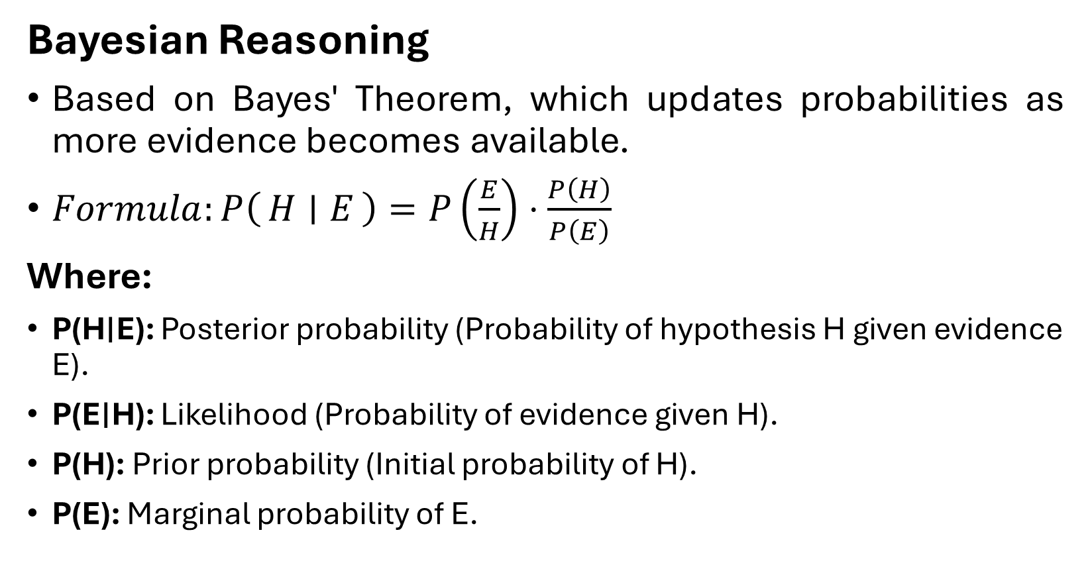
What is Probability Theory?
Bayesian Reasoning
Based on Bayes' Theorem, which updates probabilities as more evidence becomes available.
$Formula:P\left(H ∣ E\right)=P\left(\frac{E}{H}\right)⋅\frac{P\left(H\right)}{P\left(E\right)}$
Where:
P(H∣E): Posterior probability (Probability of hypothesis H given evidence E).
P(E∣H): Likelihood (Probability of evidence given H).
P(H): Prior probability (Initial probability of H).
P(E): Marginal probability of E.

Slide 12
Logic-Based Representation in Detail
Components
Syntax
Rules for writing valid expressions.
Example: (A ∧ B) → C.
Semantics
Meaning of the expressions.
Example: "If A and B are true, then C is true.“
Inference Mechanism
Uses logical rules to draw conclusions.
Example: Modus Ponens (If A → B and A is true, then B is true).
Applications
Knowledge-based systems (e.g., ELIZA).
Expert systems for diagnosis.

Slide 13
Probabilistic-Based Representation in Detail
Components
Probability Distribution
Assigns probabilities to events.
Example: P(Rain) = 0.7.
Conditional Probabilities
Model dependencies.
Example: P(Traffic | Rain) = 0.8.
Bayesian Networks:
Graphical models to represent dependencies among variables.
Applications:
Weather forecasting.
Recommendation systems.

Slide 14
Comparison of Logic-Based and Probabilistic-Based Representation
Aspect | Logic-Based | Probabilistic-Based
Focus | Deterministic reasoning | Uncertainty handling
Approach | Deductive reasoning | Bayesian reasoning
Strengths | Precision and structure | Handles real-world ambiguity
Examples | Expert systems | Medical diagnosis

Slide 15
Case Studies
Logic-Based Systems: ELIZA
Early chatbot designed to simulate human conversation using simple logical rules.
Worked on pattern matching and pre-defined responses.
Example Interaction:
Input: "I feel sad.“
Output: "Why do you feel sad?“
Logic-Based Systems: STUDENTA
system designed to solve algebraic problems.
Used logical rules to parse problems and solve equations.
Example:
Solving 2x + 3 = 7.

Slide 16
Key Points
Differentiating data, information, and knowledge helps structure AI systems.
Knowledge Representation organizes knowledge for reasoning and decision-making.
Logic-Based and Probabilistic-Based approaches are used based on system requirements.
Case studies like ELIZA and STUDENT illustrate practical applications of knowledge representation.

